Slide 1
Isolation Forest Algorithm
By:
Dr. Kamal Kant Verma
Associate Professor
Division of Machine Learning
School of Computer Science and Engineering

Slide 2
Isolation Forest
Isolation Forest is a technique for identifying outliers in data that was first introduced by Fei Tony Liu and Zhi-Hua Zhou in 2008. The approach employs binary trees to detect anomalies, resulting in a linear time complexity and low memory usage that is well-suited for processing large datasets.
Isolation Forest is a machine learning algorithm specifically designed for anomaly detection.
It is based on the principle that anomalies are rare and distinct, making them easier to isolate from the rest of the data.
This algorithm is efficient and effective, particularly for high-dimensional data or data with complex patterns.

Slide 3
Isolation Forests Anomaly Detection
Isolation Forests(IF), similar to Random Forests, are build based on decision trees. And since there are no pre-defined labels here, it is an unsupervised model.
Isolation Forests were built based on the fact that anomalies are the data points that are “few and different”.
In an Isolation Forest, randomly sub-sampled data is processed in a tree structure based on randomly selected features. The samples that travel deeper into the tree are less likely to be anomalies as they required more cuts to isolate them. Similarly, the samples which end up in shorter branches indicate anomalies as it was easier for the tree to separate them from other observations.

Slide 4
How do Isolation Forests work?
Isolation Forests outlier detection are nothing but an ensemble of binary decision trees. And each tree in an Isolation Forest is called an Isolation Tree (iTree). The algorithm starts with the training of the data, by generating Isolation Trees.
It uses the average of the predictions by several decision trees when assigning the final anomaly score to a given data point. Unlike other anomaly detection algorithms, which first define what’s “normal” and then report anything else as anomalous, Isolation Forest attempts to isolate anomalous data points from the get go (start).

Slide 5
Step by Step Guide on How Isolation Forest Work
When given a dataset, a random sub-sample of the data is selected and assigned to a binary tree.
Branching of the tree starts by selecting a random feature (from the set of all N features) first. And then branching is done on a random threshold ( any value in the range of minimum and maximum values of the selected feature).
If the value of a data point is less than the selected threshold, it goes to the left branch else to the right. And thus a node is split into left and right branches.
This process from step 2 is continued recursively till each data point is completely isolated or till max depth(if defined) is reached.
The above steps are repeated to construct random binary trees.

Slide 6
After creating an ensemble of iTrees (Isolation Forest), the model training is complete. During scoring, the system traverses a data point through all the trees that were trained earlier. Now, an ‘anomaly score’ is assigned to each of the data points based on the depth of the tree required to arrive at that point. This score is an aggregation of the depth obtained from each of the iTrees. An anomaly score of -1 assigns anomalies and 1 to normal points based on the contamination parameter (percentage of anomalies present in the data).

Slide 7
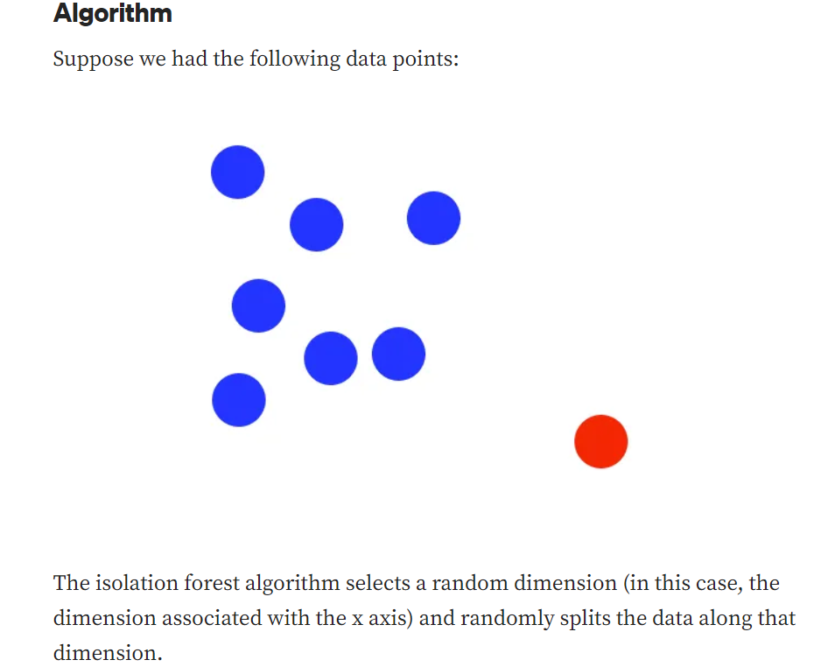

Slide 8
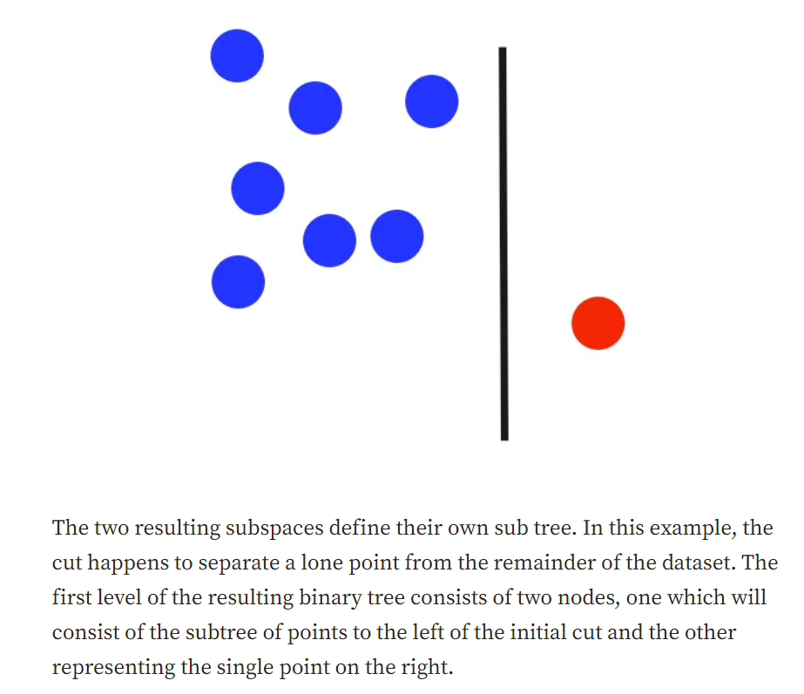

Slide 9
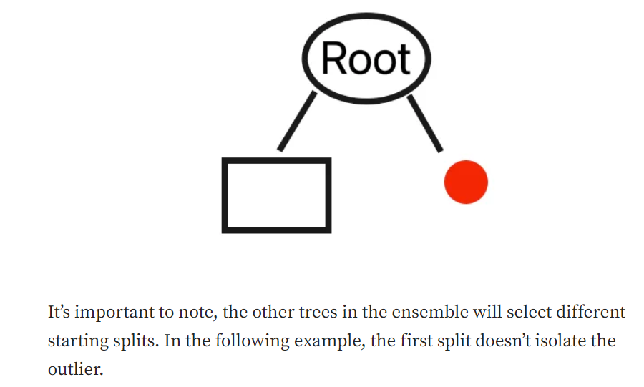

Slide 10
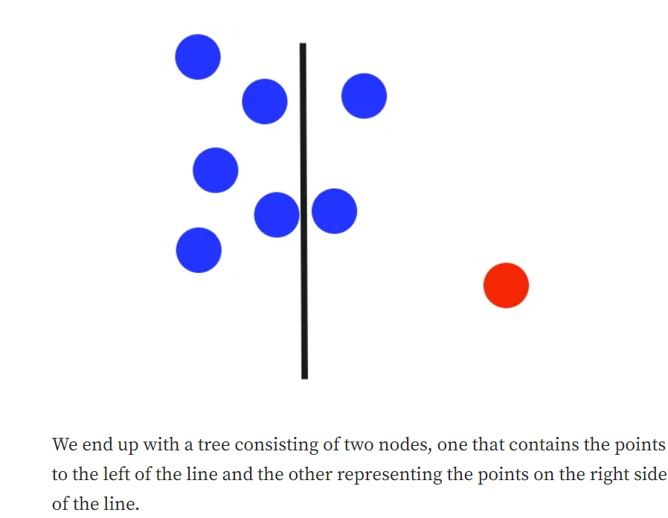

Slide 11
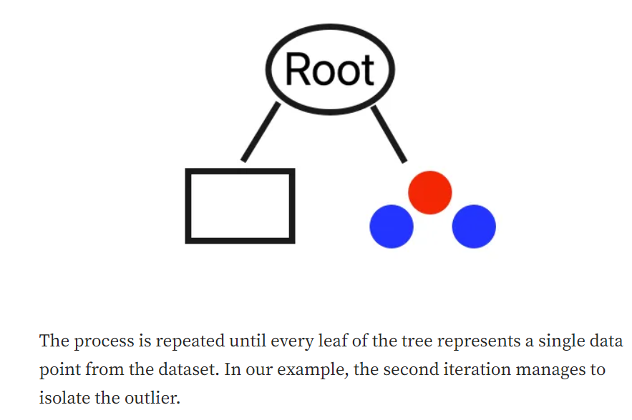

Slide 12
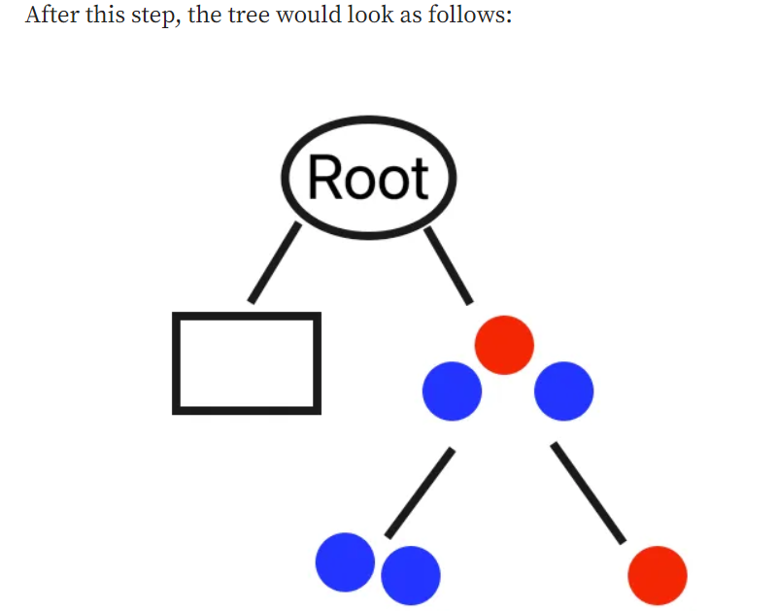
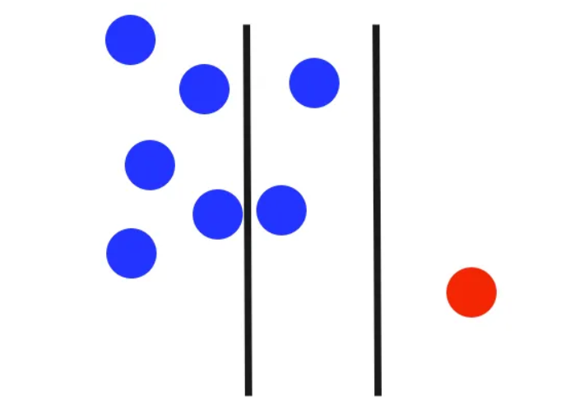

Slide 13
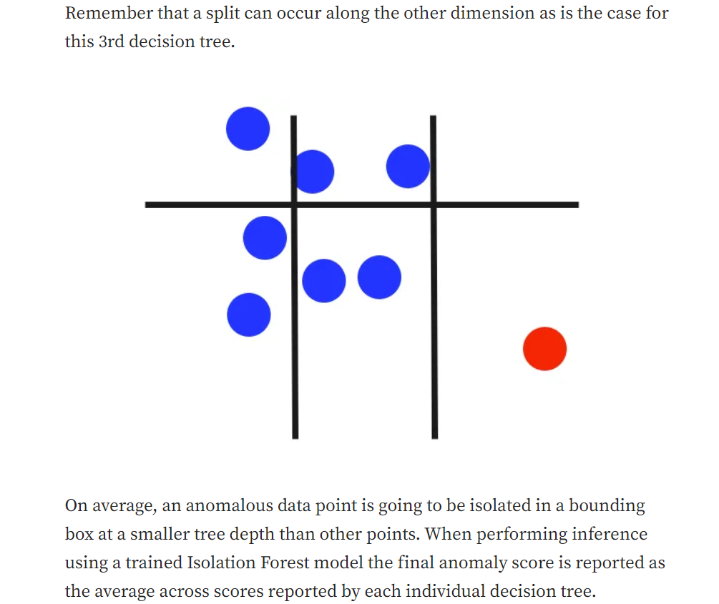

Slide 14
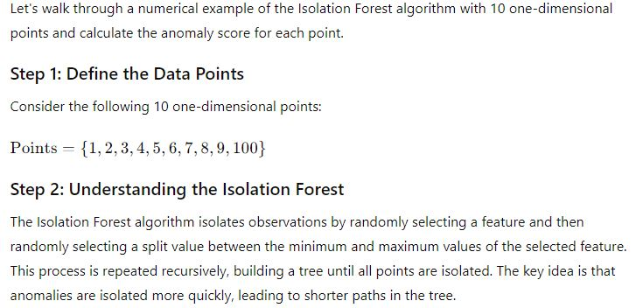

Slide 15
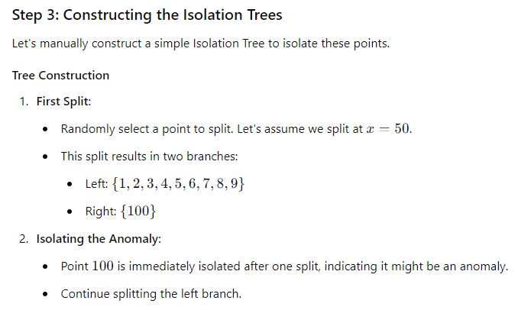

Slide 16
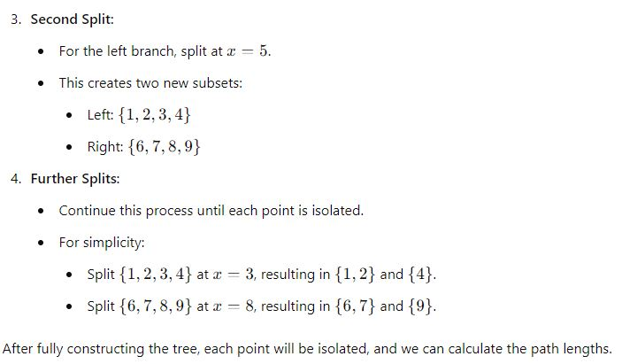

Slide 17
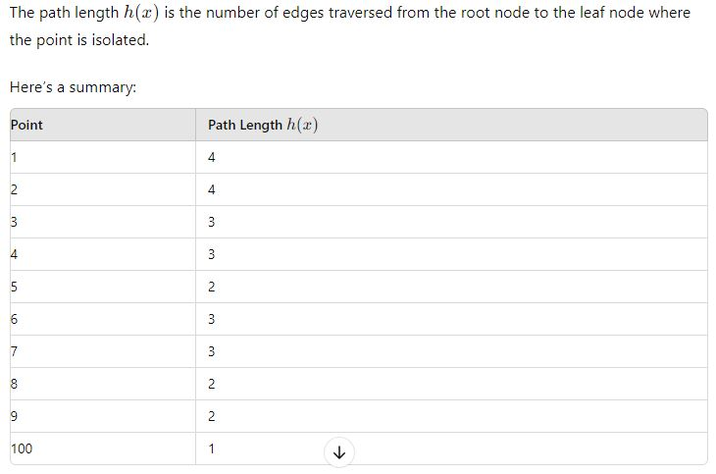
After fully constructing the tree, each point will be isolated, and we can calculate the path lengths.

Slide 18
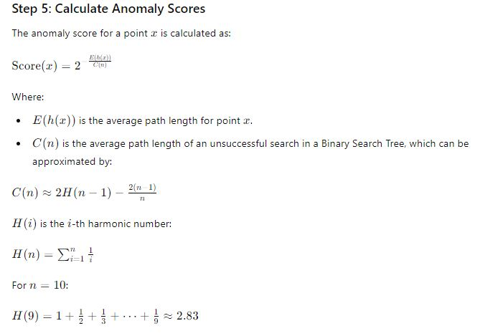

Slide 19
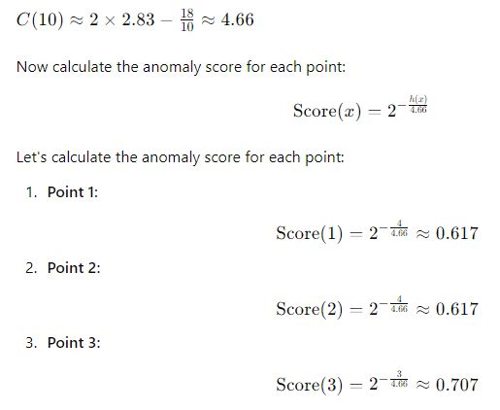

Slide 20
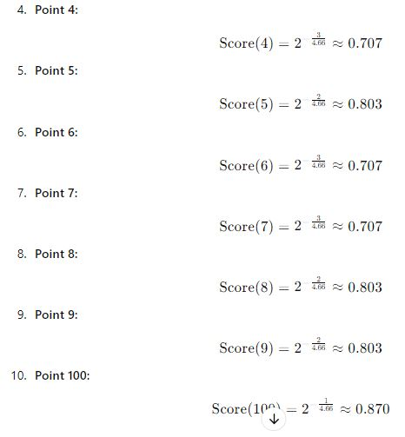

Slide 21
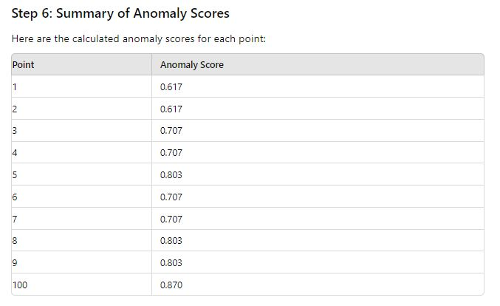

Slide 22
Conclusion
In this example, point 100 has the highest anomaly score, indicating it is the most likely anomaly in the dataset. The points closer to the bulk of the distribution (like 1 through 9) have lower anomaly scores, indicating they are more normal.
This is a simplified example to demonstrate the concept. The actual implementation of the Isolation Forest algorithm involves constructing many trees and averaging the path lengths across these trees to compute the final anomaly scores.

Slide 23
Anomaly Detection using Isolation Forest
# Combine normal and anomaly data
data = np.vstack((normal_data, anomaly_data))
# Fit Isolation Forest model
model = IsolationForest(contamination=0.05) # Contamination parameter sets expected proportion of anomalies
model.fit(data)
import numpy as np
import matplotlib.pyplot as plt
from sklearn.ensemble import IsolationForest
# Generate synthetic data
np.random.seed(42)
normal_data = np.random.randn(1000, 2) * 2 # Normal data points
anomaly_data = np.random.randn(50, 2) * 10 # Anomaly data points

Slide 24
# Predict anomalies
predictions = model.predict(data)
# Plot the data and detected anomalies
plt.scatter(data[:, 0], data[:, 1], c=predictions, cmap=plt.cm.Paired)
plt.title("Anomaly Detection using Isolation Forest")
plt.xlabel("Feature 1")
plt.ylabel("Feature 2")
plt.show()

Slide 25
Write a program to detect anomalies in iris dataset using Isolation Forest.

